Slide 1
Spreadsheets

Slide 2
A spreadsheet is a document that stores data in a grid of horizontal rows and vertical columns.
Spreadsheet a computer program that calculates numbers and organizes information in columns and rows.
A spreadsheet is a grid of rows and columns in which you enter text, numbers, and the results of calculations.
  GRID - a network of lines that cross each other to form a series of squares or rectangles.
MS Excel is a computer program used to create electronic spreadsheets.
Within Excel users can organize data, create charts and perform calculations.
In Excel, a computerized spreadsheet is called a worksheet.
The file used to store worksheets is called a workbook.

Slide 3
Microsoft Excel Window
Microsoft Excel is an electronic spreadsheet.
You can use it to organize your data into rows and columns.
You can also use it to perform mathematical calculations quickly.
To begin this lesson, start Microsoft Excel 2007/2010.
Microsoft Excel window appears and your screen looks similar to the one shown below.

Slide 4
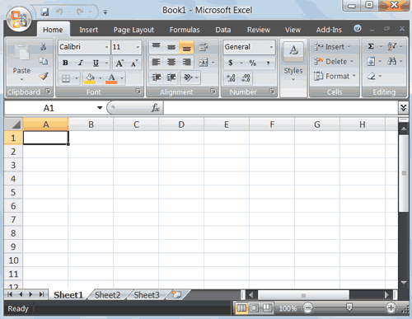
MS Excel Window

Slide 5
Worksheet
When you start Excel, you’re faced with a big empty grid made up of columns, rows and cells.
Microsoft Excel consists of worksheets.
Each worksheet contains columns and rows.
Columns are lettered A to Z and then continuing with AA, AB, AC and so on; the rows are numbered 1 to1,048,576.
The combination of a column coordinate and a row coordinate make up a cell address.
E.g. the cell located in the upper-left corner of the worksheet is cell A1, meaning column A, row 1. Cell E10 is located under column E on row 10.
You enter your data into the cells on the worksheet.

Slide 6
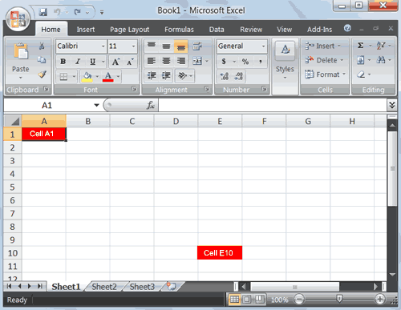
Worksheet

Slide 7
When you start Excel, you open a file that is called a workbook.
Each workbook comes with three worksheets into which you enter data.
The first workbook you’ve opened is called Book1.
Title bar indicates the name of the current workbook and the program name.
Sheet tabs appear at the bottom of the window.
It’s a good idea to rename sheet tabs to make information on each sheet easier to identify.

Slide 8
Worksheets are divided into columns, rows, and cells.
Columns go from top to bottom on the worksheet, vertically.
Each column has an alphabetical heading at the top.
Rows go across the worksheet, horizontally.
Each row also has a heading. Row headings are numbers, from 1 through 1,048,576.

Slide 9
Formula Bar
Formula Bar displays the value of the formula contained in the active cell.
Formula Bar also permits entry or editing of values or formulas.
The cell address of the cell you are in, displays in the Name Box which is located on the left side of the Formula bar.
Cell entries display on the Formula bar.
If you do not see the Formula bar in your window, perform the following steps:
  Choose the View tab.
  Click Formula Bar in the Show/Hide group. The Formula bar appears.

Slide 10
Name Box
Displays the name of the selected cell, table, chart or object
You can also use Name Box to go to a specific cell.
Just type the cell address you want to go to in the Name Box and then press Enter.
Type B10 in the Name box.
Press Enter. Excel moves to cell B10

Slide 11
Status bar
Status bar appears at the very bottom of the Excel window .
It provides information such as the sum, average, zoom, minimum, and maximum value of selected numbers.
You can change what displays on the Status bar by right-clicking on the Status bar and selecting the options you want from the Customize Status Bar menu.
You click a menu item to select it.
You click it again to deselect it.
A check mark next to an item means the item is selected.

Slide 12
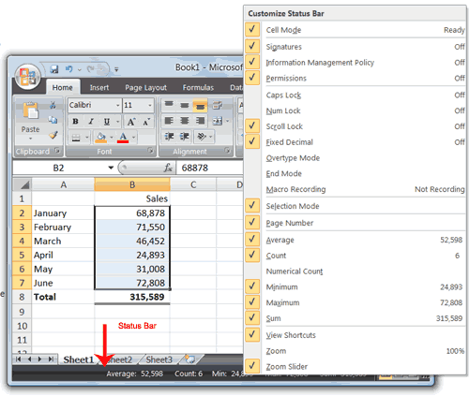

Slide 13
Move Around a Worksheet
By using the Arrow keys, you can move around your worksheet.
You can use the Down Arrow key to move downward one cell at a time.
You can use the Up Arrow key to move upward one cell at a time.
You can use the Tab key to move across the page to the right, one cell at a time.
You can hold down the Shift key and then press the Tab key to move to the left, one cell at a time.
You can use the right and left arrow keys to move right or left one cell at a time.
The Page Up and Page Down keys move up and down one page at a time.
If you hold down the Ctrl key and then press the Home key, you move to the beginning of the worksheet.

Slide 14
Go To Cells Quickly
Two keyboard shortcuts for moving quickly from one cell in a worksheet to a cell in a different part of the worksheet.
1. Go to -- F5
The F5 function key is the "Go To" key. If you press F5 key, you are prompted for the cell to which you wish to go.
Enter the cell address, and the cursor jumps to that cell.
Press F5. The Go To dialog box opens.
Type J3 in the Reference field.
Press Enter. Excel moves to cell J3.
2. Go to -- Ctrl+G
You can also use Ctrl+G to go to a specific cell.
Hold down the Ctrl key while you press "g" (Ctrl+g).
The Go To dialog box opens.
Type C4 in the Reference field.
Press Enter. Excel moves to cell C4.

Slide 15
Selecting cells
If you want to perform a function on a group of cells, you must first select those cells by highlighting them.
The exercises that follow teach you how to select.
To select cells A1 to E7:
Go to cell A1.
Press the F8 key. This anchors the cursor.
Note that "Extend Selection" appears on the Status bar. You are in Extend mode.
Click in cell E7. Excel highlights cells A1 to E7.
Press Esc and click anywhere on the worksheet to clear the highlighting.

Slide 16
Alternative Method: Select Cells by Dragging
You can also select an area by holding down the left mouse button and dragging the mouse over the area.
You can select noncontiguous areas of the worksheet by doing the following:
Go to cell A1.
Hold down the Ctrl key. You won't release it until step 9. Holding down the Ctrl key enables you to select noncontiguous areas of the worksheet.
Press the left mouse button.
While holding down the left mouse button, use the mouse to move from cell A1 to C5.
Continue to hold down the Ctrl key, but release the left mouse button.
Using the mouse, place the cursor in cell D7.
Press the left mouse button.
While holding down the left mouse button, move to cell F10. Release the left mouse button.
Release the Ctrl key. Cells A1 to C5 and cells D7 to F10 are selected.
Press Esc and click anywhere on the worksheet to remove the highlighting.

Slide 17
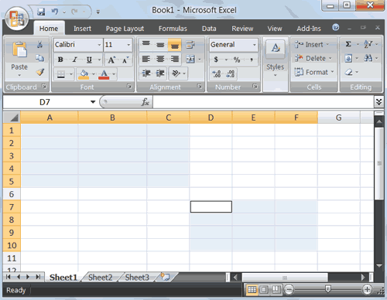

Slide 18
You can use Excel to enter all sorts of data, professional or personal.
You can enter two basic kinds of data into worksheet cells: numbers and text.
You can use Excel to create budgets, record student grades or attendance, or list the products you sell.

Slide 19
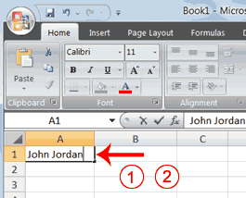
Enter Data
First, place the cursor in the cell in which you want to start entering data.
Type some data, and then press Enter.
If you need to delete, press the Backspace key to delete one character at a time.
Enter Data
1. Place the cursor in cell A1.
2. Type John Jordan. Do not press Enter at this time.
kk

Slide 20
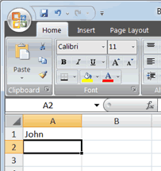
Delete Data
Backspace key erases one character at a time.
1. Press the Backspace key until Jordan is erased.
2. Press Enter. The name “John" appears in cell A1.
nn

Slide 21
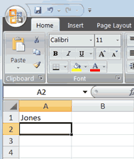
Edit a Cell
After you enter data into a cell, you can edit data by pressing F2 while you are in the cell you wish to edit.
Change "John" to "Jones."
  1. Move to cell A1.
  2. Press F2.
  3. Use the Backspace key to delete the "n" and the "h."
  4. Type nes.
  5. Press Enter.
  ll

Slide 22
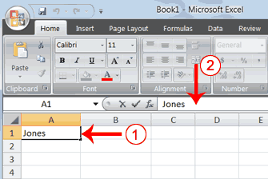
Alternate Method: Editing a Cell by Using the Formula Bar
You can also edit the cell by using the Formula bar. You change "Jones" to "Joker" in the following exercise.
  1. Move the cursor to cell A1.
  2. Click in the formula area of the Formula bar.
  nn

Slide 23
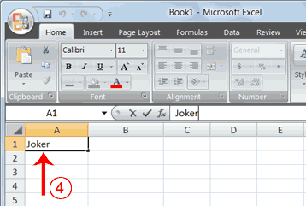
Cont…
3. Use the backspace key to erase the "s," "e," and "n."
4. Type ker.
5. Press Enter.

Slide 24
EXERCISE: Delete a cell entry
To delete an entry in a cell or a group of cells, you place the cursor in the cell or select the group of cells and press Delete.
Select cells A1 to A2.
Press the Delete key.

Slide 25
Alternate Method: Edit a Cell by Double-Clicking in the Cell
You can change "Joker" to "Johnson" as follows:
1. Move to cell A1.
2. Double-click in cell A1.
3. Press the End key. Your cursor is now at the end of your text.
4. Use the Backspace key to erase "r," "e," and "k."
5. Type hnson.
Press Enter.

Slide 26
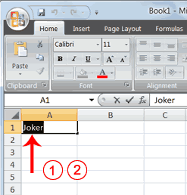
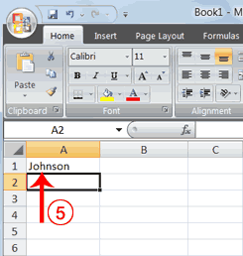

Slide 27
Change cell entry
Typing in a cell replaces the old cell entry with the new information you type.
Move the cursor to cell A1.
Type Cathy.
Press Enter. The name “Cathy" replaces “Johnson."
TEXT WRAPING
When you type text that is too long to fit in the cell, the text overlaps the next cell.
If you do not want it to overlap the next cell, you can wrap the text.
Move to cell A2.
Type Text too long to fit.
Press Enter.

Slide 28
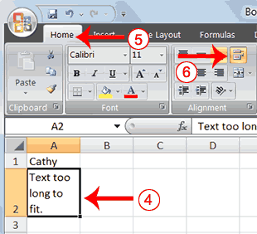
Cont…
Return to cell A2.
Choose the Home tab.
Click Wrap Text button on Home Tab, Alignment group . Excel wraps the text in the cell.

Slide 29
Saving Excel document
To save your file:
Click on File Tab. A menu appears.
Click Save. The Save As dialog box appears.
Go to the directory in which you want to save your file.
Type Lesson1 in the File Name field.
Click Save. Excel saves your file.
Close Excel
Close Microsoft Excel.
Click File Tab. A menu appears.
Click Close. Excel closes

Slide 30
Entering Excel Formulas and Formatting Data
A major strength of Excel is that you can perform mathematical calculations and format your data.
In this lesson, you learn how to perform basic mathematical calculations and how to format text and numerical data.

Slide 31
Perform Mathematical Calculations
In Microsoft Excel, you can enter numbers and mathematical formulas into cells.
Use cell references when performing mathematical calculations such as addition, subtraction, multiplication, or division.
When entering a mathematical formula, start the formula with an equal sign.
A formulae is a user defined mathematical expression which returns a value in a cell.
Use the following to indicate the type of calculation you wish to perform:
  + Addition
  - Subtraction
  * Multiplication
  / Division

Slide 32
Using formulae
Addition
  1. Type Add in cell A1.
  2. Press Enter. Excel moves down one cell.
  3. Type 1 in cell A2.
  4. Press Enter. Excel moves down one cell.
  5. Type 1 in cell A3.
  6. Press Enter. Excel moves down one cell.
  7. Type =A2+A3 in cell A4.
  8. Click the check mark on the Formula bar. Excel adds cell
  A1 to cell A2 and displays the result in cell A4. The formula displays on the Formula bar.
Note: Clicking the check mark on the Formula bar is similar to pressing Enter. Excel records your entry but does not move to the next cell.

Slide 33
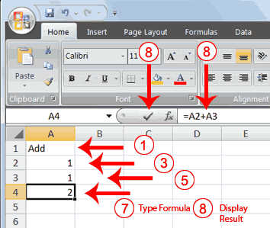

Slide 34
Subtraction
  1. Press F5. The Go To dialog box appears.
  2. Type B1 in the Reference field.
  3. Press Enter. Excel moves to cell B1.
  4. Type Subtract.
  5. Press Enter. Excel moves down one cell.
  6. Type 6 in cell B2.
  7. Press Enter. Excel moves down one cell.
  8. Type 3 in cell B3.
  9. Press Enter. Excel moves down one cell.
  10. Type =B2-B3 in cell B4.
  11. Click the check mark on the Formula bar. Excel subtracts cell B3 from cell B2 and the result displays in cell B4. The formula displays on the Formula bar.

Slide 35
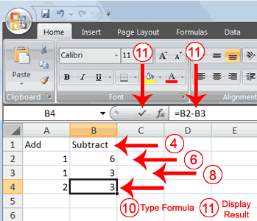

Slide 36
Multiplication
  1. Hold down the Ctrl key while you press "g" (Ctrl+g). The Go To dialog box appears.
  2. Type C1 in the Reference field.
  3. Press Enter. Excel moves to cell C1
  4. Type Multiply.
  5. Press Enter. Excel moves down one cell.
  6. Type 20 in cell C2.
  7. Press Enter. Excel moves down one cell.
  8. Type 5 in cell C3.
  9. Press Enter. Excel moves down one cell.
  10. Type =C2*C3 in cell C4.
  11. Click the check mark on the Formula bar. Excel multiplies C1 by cell C2 and displays the result in cell C3. The formula displays on the Formula bar.

Slide 37
Division
  1. Press F5.
  2. Type D1 in the Reference field.
  3. Press Enter. Excel moves to cell D1.
  4. Type Divide.
  5. Press Enter. Excel moves down one cell.
  6. Type 250 in cell D2.
  7. Press Enter. Excel moves down one cell.
  8. Type 50 in cell D3.
  9. Press Enter. Excel moves down one cell.
  10. Type =D2/D3 in cell D4.
  11. Click the check mark on the Formula bar. Excel divides cell D2 by cell D3 and displays the result in cell D4. The formula displays on the Formula bar.

Slide 38
Cont…
When creating formulas, you can reference cells and include numbers.
All of the following formulas are valid:
  =A2/B2
  =A2+12-B3
  =A2*B2+12
  =24+53

Slide 39
Perform Advanced Mathematical Calculations
When you perform mathematical calculations in Excel, be careful of precedence (order of importance).
Calculations are performed from left to right, with multiplication and division performed before addition and subtraction.
Exercise
  1. Move to cell A7.
  2. Type =3+3+12/2*4.
  3. Press Enter.
  Note: Microsoft Excel divides 12 by 2, multiplies the answer by 4, adds 3, and then adds another 3. The answer, 30, displays in cell A7

Slide 40
To change the order of calculation, use parentheses (brackets).
Microsoft Excel calculates information in parentheses first.
1. Double-click in cell A7.
2. Edit the cell to read =(3+3+12)/2*4.
3. Press Enter.
Note: Microsoft Excel adds 3 plus 3 plus 12, divides the answer by 2, and then multiplies the result by 4. The answer, 36, displays in cell A7.

Slide 41
Perform Automatic Calculations
By default, Microsoft Excel recalculates the worksheet as you change cell entries.
Using cell references makes it easier for excel to perform automatic calculations.
This makes it easy to correct mistakes and analyze a variety of scenarios.

Slide 42
Cell Reference Operators
Worksheets are divided into columns, rows, and cells.
On the worksheet, the rectangular area where a row and a column intersect is known as a cell.
Cell references identify individual cells or cell ranges in columns and rows.
Cell references tell Excel where to look for values to use in a formula.
Use cell references in formulas, so that Excel can automatically update results when values change or when you copy formulas.

Slide 43
Using Reference Operators
Reference operators refer to a cell or a group of cells.
There are two types of reference operators:
1. Range
A range reference refers to all the cells between and including the reference.
A range reference consists of two cell addresses separated by a colon.
The reference A1:A3 includes cells A1, A2, and A3.
The reference A1:C3 includes cells A1, A2, A3, B1, B2, B3, C1, C2, and C3.
2. Union
A union reference includes two or more references.
A union reference consists of two or more range references, numbers, or cell addresses separated by a comma.
The reference A7,B8:B10,C9,10 refers to cells A7, B8 to B10, C9 and the number 10.

Slide 44
Examples of cell references.
A10 – the cell in column A and row 10
A10,A20 - cell A10 and cell A20
A10:A20 - the range of cells in column A and rows 10 through 20
B15:E15 = the range of cells in row 15 and columns B through E
A10:E20 - the range of cells in columns A through E and rows 10 through 20.

Slide 45
Other numbers and how to enter them
To enter fractions, leave a space between the whole number and the fraction. For example, 1 1/8.
To enter a fraction only, enter a zero first, for example, 0 1/4. If you enter 1/4 without the zero, Excel will interpret the number as a date, January 4.
If you type (100) to indicate a negative number by parentheses, Excel will display the number as -100.

Slide 46
Functions
A function is a prewritten formula that performs calculations using specific values in a particular order.
  A formula is an equation that performs operations on worksheet data.
A predefined formula – a formula that Excel has already built for you – that performs calculations by using specific values in a particular order or structure.
Use functions to add up values, calculate averages, find the smallest or largest value in a range of values.
Excel has many functions that can be useful for quickly finding the sum, average, count, maximum value, and minimum value for a range of cells.

Slide 47
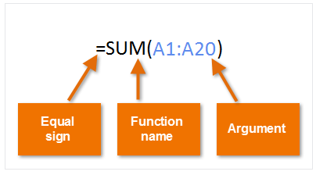
Parts of a function
In order to work correctly, a function must be written in a specific way, which is called the syntax.
The basic syntax for a function is the equals sign (=), the function name (SUM, for example), and one or more arguments.
Arguments contain the information you want to calculate.
The function in the example below would add the values of the cell range A1:A20.
A1:A20 is the information, called the argument, that tells the SUM function what to add.

Slide 48
Working with arguments
Arguments can refer to both individual cells and cell ranges and must be enclosed within parentheses (brackets).
You can include one argument or multiple arguments, depending on the syntax required for the function.
For example, the function =AVERAGE(B1:B9) would calculate the average of the values in the cell range B1:B9.
This function contains only one argument.
Multiple arguments must be separated by a comma.
For example, the function =SUM(A1:A3, C1:C2, E1) will add the values of all the cells in the three arguments.

Slide 49
Creating a function
Examples of commonly used functions in Excel.
  SUM: This function adds all of the values of the cells in the argument.
  AVERAGE: This function determines the average of the values included in the argument. It calculates the sum of the cells and then divides that value by the number of cells in the argument.
  COUNT: This function counts the number of cells with numerical data in the argument. This function is useful for quickly counting items in a cell range.
  MAX: This function determines the highest cell value included in the argument.
  MIN: This function determines the lowest cell value included in the argument.

Slide 50
You can find these Functions on a Home Tab under Editing Group.
As prewritten formulas, functions simplify the process of entering calculations.
Using functions, you can easily and quickly create formulas that might be difficult to build for yourself.
Functions differ from regular formulas in that you supply the value but not the operators, such as +, -, *, or /.
For example, you can use the SUM function to add.

Slide 51
When using a function, remember the following:
  1. Use an equal sign to begin a formula.
  2. Specify the function name.
  3. Enclose arguments within parentheses.
    Arguments are values on which you want to perform the
    calculation. For example, arguments specify the numbers or cells you want to add.
  4. Use a comma to separate arguments.

Slide 52
Example of a function
=SUM(2,13,A1,B2:C7)
In this function:
  1. The equal sign begins the function.
  2. SUM is the name of the function.
  3. 2, 13, A1, and B2:C7 are the arguments.
  4. Parentheses enclose the arguments.
  5. Commas separate the arguments.
NOTE: After you type the first letter of a function name, the AutoComplete list appears. You can double-click on an item in the AutoComplete list to complete your entry quickly. Excel will complete the function name and enter the first parenthesis.

Slide 53
Exercise
  1. Open Microsoft Excel.
  2. Type 12 in cell B1.
  3. Press Enter.
  4. Type 27 in cell B2.
  5. Press Enter.
  6. Type 24 in cell B3.
  7. Press Enter.
  8. Type =SUM(B1:B3) in cell A4.
  9. Press Enter. The sum of cells B1 to B3, which is 63, appears.

Slide 54
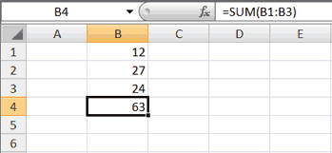

Slide 55
AutoSum
You can use the AutoSum button Σ on the Home Tab to automatically add a column or row of numbers.
When you press the AutoSum button Σ, Excel selects the numbers it thinks you want to add.
If you click the check mark on the Formula bar or press the Enter key, Excel adds the numbers.
If Excel's guess as to which numbers you want to add is wrong, you can select the cells you want.

Slide 56
EXERCISE: AutoSum
The following steps illustrates AutoSum:
  1.Go to cell F1.
  2. Type 3.
  3. Press Enter. Excel moves down one cell.
  4. Type 3.
  5. Press Enter. Excel moves down one cell.
  6. Type 3.
  7. Press Enter. Excel moves down one cell to cell F4.
  8. Choose the Home tab.
  9. Click the AutoSum button Σ in the Editing group. Excel selects cells F1 through F3 and enters a formula in cell F4.
  10. Press Enter. Excel adds cells F1 through F3 and displays the result in cell F4.

Slide 57
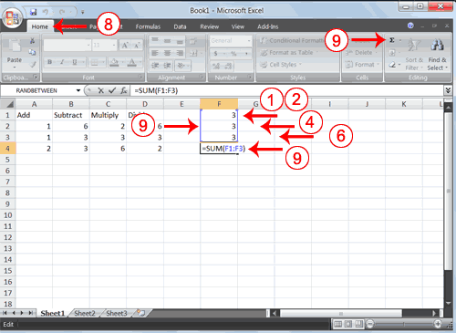

Slide 58
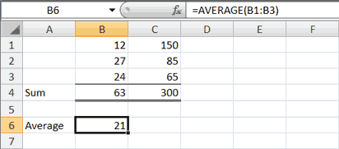
Calculate an Average
You can use the AVERAGE function to calculate the average of a series of numbers.
Do the following exercise:
1. Move to cell A6.
2. Type Average. Press the right arrow key to move to cell B6.
3. Type =AVERAGE(B1:B3).
4. Press Enter. The average of cells B1 to B3, which is 21, appears.
ll

Slide 59
Calculate an Average with the AutoSum Button
In Microsoft Excel, you can use the AutoSum button to calculate an average.
Do the following exercise:
1. Move to cell C6.
2. Choose the Home tab.
3. Click the down arrow next to the AutoSum button .
4. Click Average.
5. Select cells C1 to C3.
6. Press Enter. The average of cells C1 to C3, which is 100, appears.

Slide 60
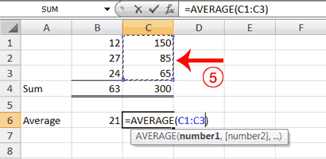

Slide 61
Find the Lowest Number
You can use the MIN function to find the lowest number in a series of numbers.
Do the following:
1. Move to cell A7.
2. Type Min.
3. Press the right arrow key to move to cell B7.
4. Type = MIN(B1:B3).
5. Press Enter. The lowest number in the series, which is 12, appears.
Note: You can also use the drop-down button next to the AutoSum button to calculate minimums, maximums, and counts.

Slide 62
Find the Highest Number
You can use the MAX function to find the highest number in a series of numbers.
Do the following:
1. Move to cell A8.
2. Type Max.
3. Press the right arrow key to move to cell B8.
4. Type = MAX(B1:B3).
5. Press Enter. The highest number in the series, which is 27, appears.

Slide 63
Count the Numbers in a Series of Numbers
You can use the count function to count the number of numbers in a series.
Do the following:
1. Move to cell A9.
2. Type Count.
3. Press the right arrow key to move to cell B9.
4. Choose the Home tab.
5. Click the down arrow next to the AutoSum button . .
6. Click Count Numbers. Excel places the count function in cell C9 and takes a guess at which cells you want to count.
The guess is incorrect, so you must select the proper cells.
7. Select B1 to B3.
8. Press Enter. The number of items in the series, which is 3, appears.

Slide 64
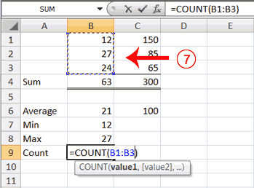

Slide 65
Find more functions
Excel offers many other useful functions, such as date and time functions and functions you can use to manipulate text.
To see all the other functions
Click the Sum button in the Editing group on the Home tab.
Click More Functions in the list.
In the Insert Function dialog box that opens, you can search for a function.

Slide 66

Align Cell Entries
When you type text into a cell, by default your entry aligns with the left side of the cell.
When you type numbers into a cell, by default your entry aligns with the right side of the cell.
You can change the cell alignment.
You can center, left-align, or right-align any cell entry.
Look at cells A1 to D1.
Note that they are aligned with the left side of the cell.
ll

Slide 67
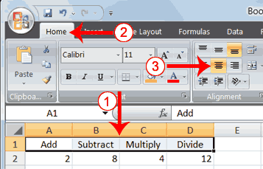
Align Centre
To center cells A1 to D1:
  1. Select cells A1 to D1.
  2. Choose the Home tab.
  3. Click the Center button in the Alignment group. Excel centers each cell's content.

Slide 68
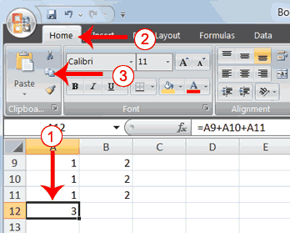
Cut, copy and paste
Contents of a cell can be copied/moved to another location in the same or different worksheet by using the copy, cut and paste features.
Keyboard shortcuts can also be used to do the copy, cut and paste actions.
  Ctrl +C
  Ctrl +X
  Ctrl +V
  l

Slide 69
Insert and Delete Columns and Rows
You can insert and delete columns and rows.
When you delete a column, you delete everything in the column from the top of the worksheet to the bottom of the worksheet.
When you delete a row, you delete the entire row from left to right.
Inserting a column or row inserts a completely new column or row.

Slide 70
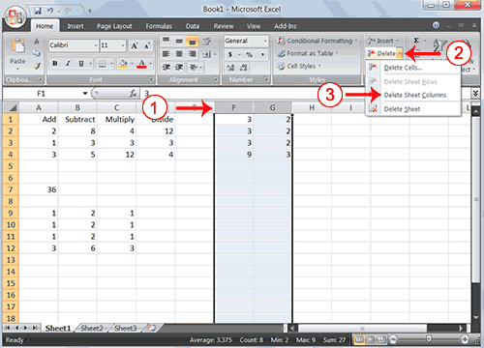
Cont.…

Slide 71
Cont.…
To delete columns F and G:
1. Click the column F indicator and drag to column G.
2. Click the down arrow next to Delete in the Cells group. A menu appears.
3. Click Delete Sheet Columns. Excel deletes the columns you selected.
4. Click anywhere on the worksheet to remove your selection.

Slide 72
Cont.…
To delete rows 7 through 12:
1. Click the row 7 indicator and drag to row 12.
2. Click the down arrow next to Delete in the Cells group. A menu appears.
3. Click Delete Sheet Rows. Excel deletes the rows you selected.
4. Click anywhere on the worksheet to remove your selection.

Slide 73
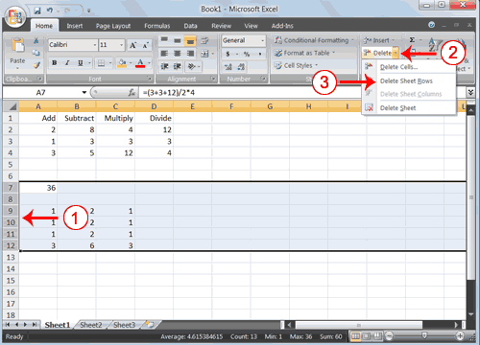

Slide 74
Cont.…
To insert a column:
1. Click on A to select column A.
2. Click the down arrow next to Insert in the Cells group. A menu appears.
3. Click Insert Sheet Columns. Excel inserts a new column. Click anywhere on the worksheet to remove your selection.
To insert rows:
1. Click on 1 and then drag down to 2 to select rows 1 and 2.
2. Click the down arrow next to Insert in the Cells group. A menu appears.
3. Click Insert Sheet Rows. Excel inserts two new rows.
4. Click anywhere on the worksheet to remove your selection.

Slide 75
QUICK WAYS TO ENTER DATA
There are two time-savers you can use to enter data in Excel:
  AutoComplete and AutoFill
AutoComplete: Type a few letters in a cell, and Excel can fill in the remaining characters for you.
  AutoComplete detects when a value you are entering is similar to previously entered values
  AutoComplete works for text or for text with numbers. It does not work for numbers only, for dates, or for times.
AutoFill: Type one or more entries in an intended series, and then extend the series.
With AutoFill, you can quickly enter the months of the year, the days of the week, multiples of 2 or 3, or other data in a series. You type one or more entries, and then extend the series.

Slide 76
Sometimes Excel can’t calculate a formula because the formula contains an error.
If that happens, you’ll see an error value in a cell instead of a result.
Here are three common error values:
#### The column isn’t wide enough to display the contents of the cell. To fix the problem, you can increase column width, shrink the contents to fit the column, or apply a different number format.
#REF! A cell reference isn’t valid. Cells may have been deleted or pasted over.
#NAME? You may have misspelled a function name or used a name that Excel doesn’t recognize.
#DIV/0! Excel displays the #DIV/0! error when a formula tries to divide a number by 0 or an empty cell.
#VALUE! Wrong type of argument in a function or wrong type of operator. This error is most often the result of specifying a mathematical operation with one or more cells that contain text.

Slide 77
Cell references
You can type cell references directly into cells, or you can enter cell references by clicking cells, which avoids typing errors.
Three types of cell references:
  Relative,
  Absolute and
  Mixed.

Slide 78
Relative references automatically change as they’re copied down a column or across a row.
Using this method the formula adjust itself relatively to the current cell where it has been copied.
Absolute references are fixed. They don’t change if you copy a formula from one cell to another. Absolute references have dollar signs ($) like this: $A$1.
  You use absolute cell references to refer to cells that you don’t want to change as the formula is copied.

Slide 79
Mixed reference has either an absolute column and a relative row, or an absolute row and a relative column.
As a mixed reference is copied from one cell to another, Absolute reference stays the same but the Relative reference changes.

Slide 80
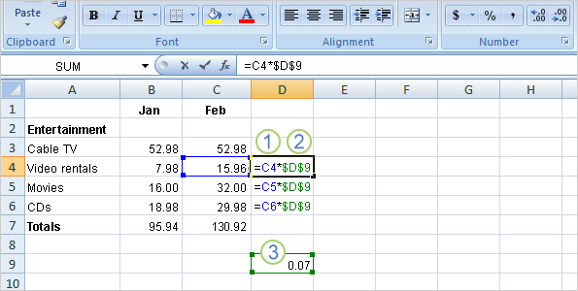
Say you receive some entertainment coupons offering a
7 percent discount for video rentals, movies, and CDs. How much could you save in a month by using the discounts?
You could use a formula to multiply those February expenses by 7 percent.
So start by typing the discount rate .07 in the empty cell D9, and then type the formula in cell D4.

Slide 81
Then in cell D4, type =C4*. Remember that relative cell reference will change from row to row.
Enter a dollar sign ($) and D to make an absolute reference to column D, and $9 to make an absolute reference to row 9. Your formula will multiply the value in cell C4 by the value in cell D9.
Cell D9 contains the value for the 7 percent discount.
You can copy the formula from cell D4 to D5 by using the fill handle.
As the formula is copied, the relative cell reference changes from C4 to C5, while the absolute reference to the discount in D9 does not change; it remains as $D$9 in each row it is copied to.

Slide 82
Create a chart
A chart, or graph, is a visual representation of a set of data.
A chart is a graphic representation of data in a worksheet.
A chart is a drawing which shows information using lines and curves to show amounts.
With a chart, you can transform worksheet data to show comparisons, patterns and trends.
  Trend – a change in a situation
So instead of having to analyze columns of worksheet numbers, you can see at a glance what the data means.
A chart gets your point across—fast.

Slide 83
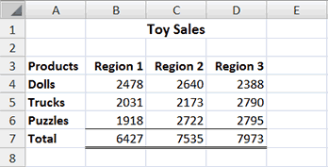
Creating a Column chart
Start by creating the worksheet below exactly as shown.
After you have created the worksheet, you are read to create your chart.

Slide 84
Cont.…
Do the following:
1. Select cells A3 to D6. You must select all the cells containing the data you want in your chart. You should also include the data labels.
2. Choose the Insert tab.
3. Click the Column button in the Charts group. A list of column chart sub-types types appears.
4. Click the Clustered Column chart sub-type.
Excel creates a Clustered Column chart and the Chart Tools context tabs appear.

Slide 85
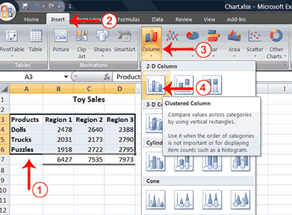

Slide 86
Apply a Chart Layout
Context tabs are tabs that appear only when you need them, Called Chart Tools.
There are three chart context tabs: Design, Layout, and Format.
The tabs become available when you create a new chart or when you click on a chart.
You can use these tabs to customize your chart.
You can determine what your chart displays by choosing a layout.
E.g. the layout you choose determines whether your chart displays a title, where the title displays, whether the chart has axis labels and so on.
Excel provides several layouts from which you can choose.

Slide 87
Cont.…
Do the following:
1. Click your chart. The Chart Tools become available.
2. Choose the Design tab.
3. Click the Quick Layout button in the Chart Layout group.
A list of chart layouts appears.
4. Click Layout 5. Excel applies the layout to your chart.

Slide 88
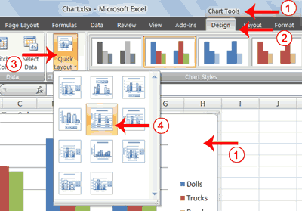

Slide 89
Add Labels to a chart
When you apply a layout, Excel may create areas where you can insert labels.
You use labels to give your chart a title or to label your axes.
When you applied layout 5, Excel created label areas for a title and for the vertical axis.
Do the following:
1. Select Chart Title. Click on Chart Title and then place your cursor before the C in Chart and hold down the Shift key while you use the right arrow key to highlight the words Chart Title.
2. Type Toy Sales. Excel adds your title.
3. Select Axis Title. Click on Axis Title. Place your cursor before the A in Axis. Hold down the Shift key while you use the right arrow key to highlight the words Axis Title.
4. Type Sales. Excel labels the axis.
5. Click anywhere on the chart to end your entry.

Slide 90
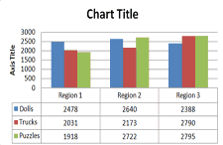
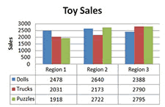
Add labels to a chart
Before
After

Slide 91
Switch Data in the chart
If you want to change what displays in your chart, you can switch from row data to column data and vice versa.
Do the following:
1. Click your chart. The Chart Tools become available.
2. Choose the Design tab.
3. Click the Switch Row/Column button in the Data group.
Excel changes the data in your chart.

Slide 92
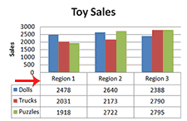
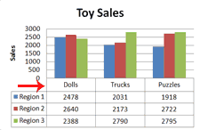
Switching data in a chart
Before
After

Slide 93
Move a Chart to a Chart Sheet
By default, when you create a chart, Excel embeds the chart in the active worksheet.
However, you can move a chart to another worksheet or to a chart sheet.
A chart sheet is a sheet dedicated to a particular chart.
By default Excel names each chart sheet sequentially, starting with Chart1.
You can change the name.
Do the following:
1. Click your chart. The Chart Tools become available.
2. Choose the Design tab.
3. Click the Move Chart button in the Location group. The Move Chart dialog box appears.
4. Click the New Sheet radio button.
5. Type Toy Sales to name the chart sheet. Excel creates a chart sheet named Toy Sales and places your chart on it.

Slide 94
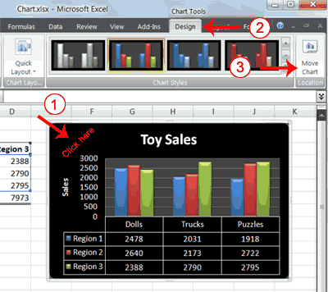

Slide 95
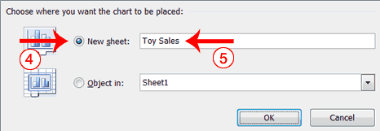

Slide 96
Change the Chart Type
You can change the chart type from a column chart to a bar chart etc.
Do the following:
1. Click your chart. The Chart Tools become available.
2. Choose the Design tab.
3. Click Change Chart Type in the Type group. The Chart Type dialog box appears.
4. Click Bar.
5. Click Clustered Horizontal Cylinder.
6. Click OK. Excel changes your chart type.

Slide 97
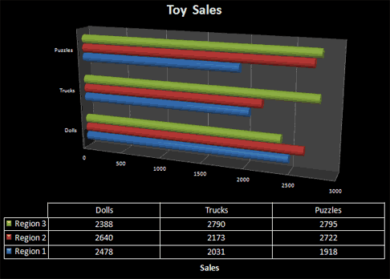

Slide 98
IF Function in MS Excel
It is used when you want to test for more than one values.
IF function checks to see if a certain condition is true or false.
  If the condition is true, the function will do one thing, if the condition is false, the function will do something else.
IF Returns a value or label if a condition specified is evaluated to TRUE and another is evaluated to FALSE.

Slide 99
IF Function looks like this:
IF( logical_test, value_if_true, value_if_false)
The three items between the round brackets of the word IF are the arguments that IF function needs.
Here's what they mean:
logical_test
  The first argument is what you want to test for.
  E.g: Is the number in the cell greater than 50?
value_if_true
  This is what you want to do if the answer to the first argument is YES. (E.g: Award PASS grade).
value_if_false
  This is what you want to do if the answer to the second argument is NO. (E.g: Award a FAIL grade.)

Slide 100
Cont.…
Here is what we're saying in the IF function above:
logical_test: Is the value in cell A1 greater than 5?
value_if_true: If the answer is Yes, display the text "Greater than Five"
value_if_false: If the answer is NO, display the text "Less than Five“
NOTE: You first tell Excel what you want to check the cell for, then what you want to do if the answer is YES, and finally what you want to do if the answer is NO. You separate each part with a comma.

Slide 101

Example
Do the following:
1. Widen the B column a bit, as we'll be putting a message in cell B1
2. Now click in cell A1 and type the number 6
3. Type the following in the formula bar of B1 (The right angle bracket after A1 means "Greater Than".)
=IF(A1 > 5, "Greater than Five", "Less than Five")
The right angle bracket ( > ) is a Conditional Operator.
4. Press Enter key on your keyboard and your spreadsheet should look as below.
ll

Slide 102
Exercise 2
IF function will asks if the value in column A is greater than the value in column B.
If it is, IF function will place the statement "A is larger" in column D. If it is not, the IF function will place the statement "B is larger" in column D.
Our IF function will be entered into cell D1 and it looks like this:
=IF(A3 > B3,"A is larger","B is larger")
Note: The two text statements "A is larger" and "B is larger" are enclosed in quotations.
  In order to add text to an Excel IF Function, it must be enclosed in quotation marks.

Slide 103
Common Logical functions
Example 3
E.g. If A3, B3, C3, D3 and E3 contained a set of marks 35, 50, 80, 60 and 45, grades are to be awarded as follows:
  80 to 100 A
  60 to 79 B
  40 to 59 C
  Below 40 Fail,
To assign a grade use,
IF (A3>=80, “A”, IF (A3>=60, “B”, If (A3>=40, “C”, “Fail”)))

